Slide 1

COMPUTER ARCHITECTURE & ITS ORGANIZATION
(UNIT IV)
Input-Output Organization
      - Peripheral Devices
      I/O Interface
      Modes of transfer
      Priority Interrupt
      DMA
      IOP
      Serial Communication.
COMPUTER ARCHITECTURE & ITS ORGANIZATON UNIT IV

Slide 2
Peripheral Devices &
I/O Interface
1

Slide 3
Overview
Computer Components
Peripheral Devices
Major Challenges in Data Transfer
Interfacing units
I/O Bus and Interface modules
I/O Commands
Memory Unit
I/O Processor (lOP)
Isolated I/O
Memory-mapped I/O
I/O Interface unit Architecture
Example of I/O Interface

Slide 4
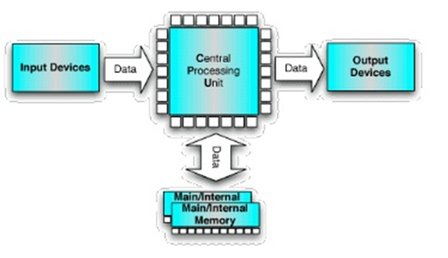
Computer Components
CPU (Central Processing Unit)
Input/ Output units
Memory/Storage units

Slide 5
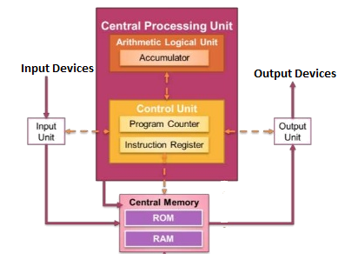
Central Processing Unit

Slide 6
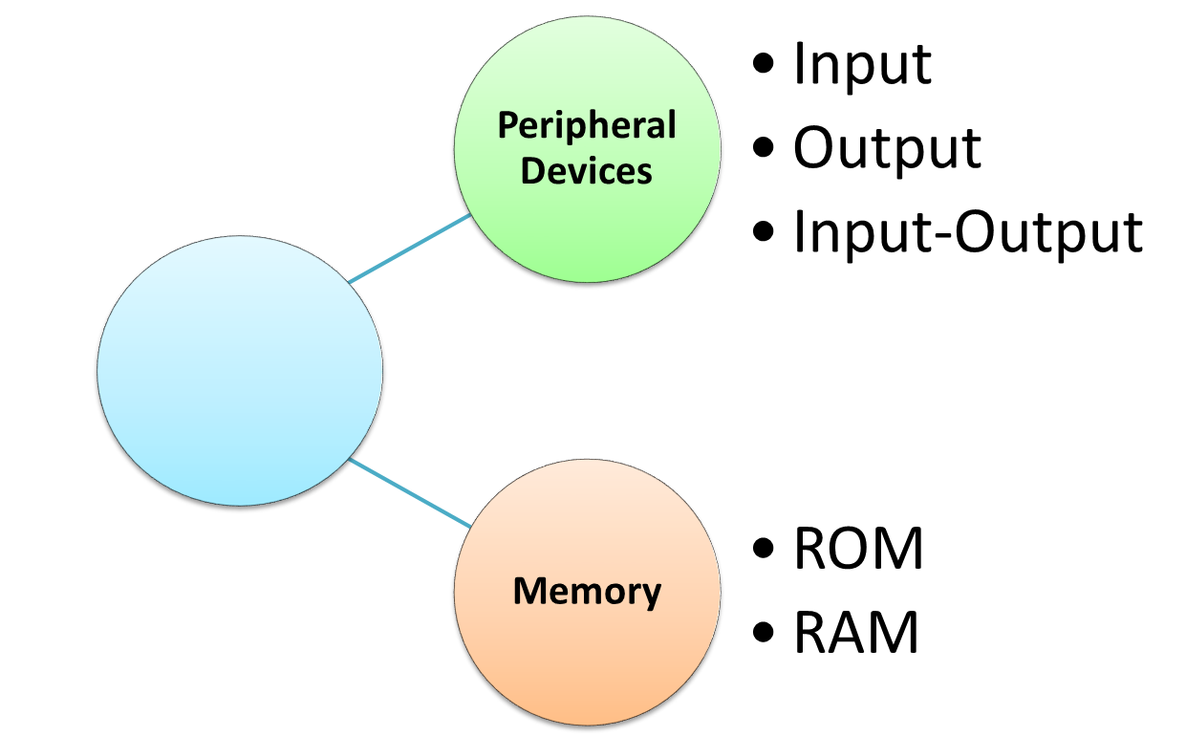
Data Transfer
CPU

Slide 7
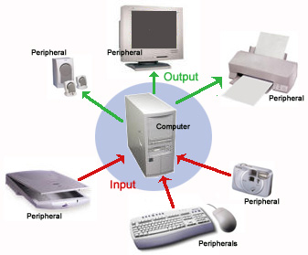
Peripheral Devices
A Peripheral Device is "an ancillary device used to put information into and get information out of the computer“
Three categories of peripheral devices
  Input peripheral devices - sends data or instructions to the computer
  Output peripheral devices - provides output from the computer
  Input-output peripheral devices - performs both input and output functions

Slide 8
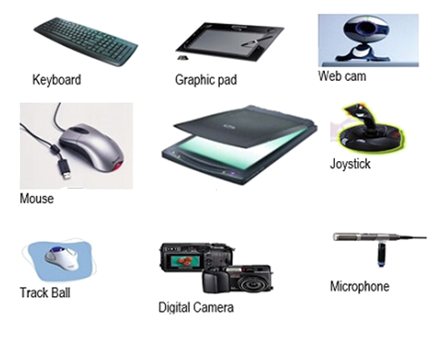
Input Peripheral Devices
Keyboard
Optical Input Devices
  Card Reader
  Paper Tape Reader
  Bar code reader
  Optical Mark Reader
Magnetic Input Devices
  Magnetic Stripe Reader
Screen Input Devices
  Touch Screen
  Light Pen
  Mouse

Slide 9
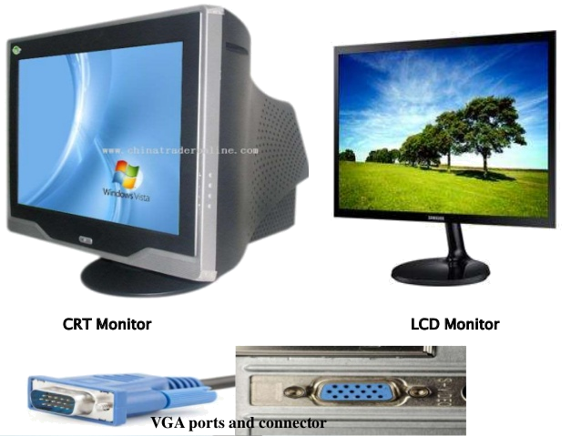
Output Peripheral Devices
Card Puncher
Paper Tape Puncher
CRT
Printer
  (Daisy Wheel,
  Dot Matrix, Laser)
Plotter
Electromechnical devices

Slide 10
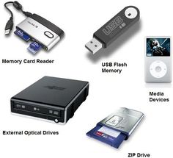
Input/Output Peripheral Devices
Memory Card
Optical Devices
USB
Zip drive
Electromagnetic devices

Slide 11
Major Challenges in Data Transfer
Peripheral devices operates with different
Signals,
Data rate,
  Word format &
  Operating modes
  Signal conversion
  Operation of Peripherals like Electromechanical or Electromagnetic Devices and CPU are different
  Conversion of signal values may be required

Slide 12
Major Challenges in Data
Transfer Cont.
  Data Transfer Rate
  Peripherals - Usually slower
  CPU or Memory - Usually faster than peripherals
  Synchronization mechanism may be needed
  Word format
  Data codes and formats are different for peripheral and CPU
  Operating modes
  Operating modes of peripherals and CPU may differ
  Should not disturb the operation of other peripherals connected to CPU

Slide 13
Interfacing units
To resolve these challenges, computer systems include special hardware components between the CPU and peripherals to supervise and synchronize all input and output transfers
These components are called Interfacing units
Provides a method for transferring information between internal storage and external I/O devices
Computer need serial communication links for interfacing them with the CPU

Slide 14
I/O Bus and Interface modules
Processor
I/O bus
Data
Addres
Control
Interface
Interface
Interface
Interface
Keyboard and display terminal
Printer
Magnetic
disk
Magnetic
tape
I/O Bus transfers information between CPU and I/O devices (peripheral devices) through their I/O interface
I/O Bus – Data lines, Address lines & Control lines

Slide 15
I/O Bus and Interface modules
Cont.
Functions of Interfacing Unit
Peripheral device is associated with interface unit
Interface unit decodes the device address and control received from I/O bus
Interprets and provides signals to the peripheral
controller
Also synchronizes and supervises the data flow
Example : Printer
To transmit data to Printer, CPU places the device address on the address lines and function code on control lines
When interface unit detects its address it activates the
path executes the function (I/O command)

Slide 16
I/O Commands
4 types of command interface
Control,
Status,
Data i/p &
Data o/p
Control command activates the specified peripheral device and initiates the function to be performed
Status command is used to test various status conditions in the interface and the peripheral devices
Data i/p command transfers the data from the peripheral devices and stores in its buffer register
Data o/p command transfers the data from the CPU to peripheral device

Slide 17
Memory Unit
Memory – ROM and RAM
    Read Only Memory (ROM)
    Non-Volatile memory
Random Access Memory (RAM)
Volatile
Unique Address
Address from the instruction is copied to Memory Address Register (MAR)
CPU either stores or retrieves the data
Notes:
i.e data stored in ROM will not change over life of the system
i.e data stored is earsed during power-off

Slide 18
Memory Unit
CPU communicates with memory unit
Memory Bus transfers information between CPU and Memory Unit
Memory Bus – Data lines, Address lines & Control lines
CPU communicate with memory and I/O bus in 3 ways
  Use two separate buses, one for memory and other for I/O devices – I/O Processor
  Use one common bus for both memory and I/O devices but have separate control lines for each – Isolated I/O
  Use two common buses for both memory and I/O devices – Memory Mapping

Slide 19
I/O Processor (lOP)
  Use two separate buses, one for memory and other for I/O devices – I/O Processor
CPU has independent sets of data, address and control instructions - for accessing memory unit and I/O devices
Occupies more memory space
Separate I/O Processor (lOP) in addition to the Central Processing Unit (CPU)
Memory communicates with both the CPU and the lOP through a memory bus

Slide 20
I/O Processor (lOP) Cont.
IOP also communicates with I/O devices through separate I/O bus with its own data, address and control lines
Purpose of the lOP is to provide an independent pathway for the transfer of information between external devices and internal memory
I/O processor is sometimes called a Data channel
CPU
Peripheral Devices
P1
P2
P3
Memory Unit
Internal Bus
IOP

Slide 21
Isolated I/O
  Use one common bus to transfer information between memory or I/O and the CPU
Separate control lines for memory transfer and I/O transfer
CPU has distinct input and output instructions associated with address of interface register
CPU places the address on the common address lines
CPU fetches and decodes the operation code
At the same time, CPU enables control lines to initiate data transfer

Slide 22
Isolated I/O Cont.
CPU enables read/write control lines to distinguish between memory and I/O transfer
    I/O transfer- I/O read and I/O write lines are enabled
    Memory transfer – memory read and memory write lines are enabled
  Isolates all I/O interface address from memory address – Isolation I/O method
Memory
Address
CPU
Address lines
Memory Read or
Memory write
Control Lines
I/O devices
I/O Read or I/O write

Slide 23
Memory-mapped I/O
  Use two common buses for both memory and I/O devices – Memory Mapping
No distinguish between memory and I/O transfer
Same address space for both memory and I/O
No specific instructions for memory or I/O transfer
CPU can manipulate I/O data using same instructions that are used to manipulate memory words
Similarly, memory data can be manipulated using I/O instructions
Only one set of read and write signals in control lines

Slide 24
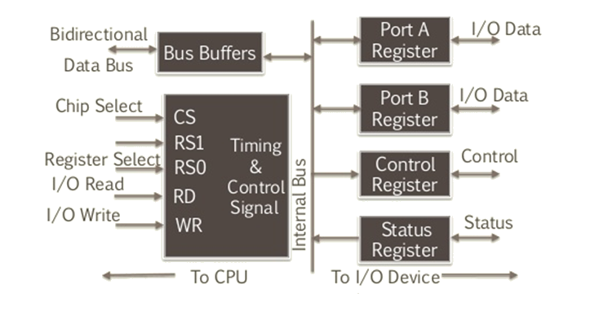
I/O Interface unit Architecture

Slide 25
I/O Interface unit Architecture
Cont.
2 data register – Port A & Port B
Control register- I/O read & write
Status register
Bus buffer
Timing and Control circuit
    Chip Select(CS) and 2 Register Select (RS)
Ports - I/O data transfer either to or from peripherals are done through ports
- Input , output or both input and output devices

Slide 26
I/O Interface unit Architecture
Cont.
Control register – Receives control from CPU
Status register – Status conditions and recording errors
Data bus in used to communicate CPU with interface unit
CS and RS determines the address of the interface register
I/O read and write control lines specifies the operation(Input or Output)
4 registers communicate directly with I/O devices

Slide 27
Example of I/O Interface
Port A – Input port
Port B – Output port
Address bus selects the register in the interface unit through Chip Select (CS) and two Register Select (RS) input RS0 & RS1
CS | RS 1 | RSO | Register selected
0 | x | x | None: data bus in high-impedance
1 | 0 | 0 | Port A Register
1 | 0 | 1 | Port B Register
1 | 1 | 0 | Control Register
1 | 1 | 1 | Status Register

Slide 28
Example of I/O Interface cont.
Content of the selected register is transferred into CPU through data bus when I/O read signal is enabled
Similarly, CPU transfers data into selected register when I/O write is selected

Slide 29
PRIORITY INTERRUPT AND MODES OF TRANSFER

Slide 30
OVERVIEW
Priority Interrupt
Types of Interrupts
  Hardware Interrupts
    Daisy Chaining
    Parallel Priority
  Software Interrupt
  Polling
Modes of Transfer
Programmable I/O
Interrupt- Driven I/O

Slide 31
INTERRUPT
An interrupt is a signal sent to the processor that interrupts the current process. It may be generated by a hardware device or a software program.
Data transfer between the CPU and the peripherals is initiated by the CPU. But the CPU cannot start the transfer unless the peripheral is ready to communicate with the CPU.
When a device is ready to communicate with the CPU, it generates an interrupt signal. A number of input-output devices are attached to the computer and each device is able to generate an interrupt request.
The main job of the interrupt system is to identify the source of the interrupt. There is also a possibility that several devices will request simultaneously for CPU communication. Then, the interrupt system has to decide which device is to be serviced first.

Slide 32
PRIORITY INTERRUPT
A priority interrupt is a system which decides the priority at which various devices, which generates the interrupt signal at the same time, will be serviced by the CPU.
The system has authority to decide which conditions are allowed to interrupt the CPU, while some other interrupt is being serviced. Generally, devices with high speed transfer such as magnetic disks are given high priority and slow devices such as keyboards are given low priority.
When two or more devices interrupt the computer simultaneously, the computer services the device with the higher priority first.

Slide 33
TYPES OF INTERRUPTS:
Hardware Interrupts
Software Interrupts

Slide 34
HARDWARE INTERRUPTS
When the signal for the processor is from an external device or hardware then this interrupts is known as hardware interrupt.
Let us consider an example: when we press any key on our keyboard to do some action, then this pressing of the key will generate an interrupt signal for the processor to perform certain action. Such an interrupt can be of two types:
Maskable Interrupt
The hardware interrupts which can be delayed when a much high priority interrupt has occurred at the same time.
Non Maskable Interrupt
The hardware interrupts which cannot be delayed and should be processed by the processor immediately.

Slide 35
SOFTWARE INTERRUPTS
The interrupt that is caused by any internal system of the computer system is known as a software interrupt. It can also be of two types:
Normal Interrupt
The interrupts that are caused by software instructions are called Normal software interrupts.
Exception
Unplanned interrupts which are produced during the execution of some program are called exceptions, such as division by zero.

Slide 36
DAISY CHAINING PRIORITY INTERRUPT
In this method, all the device, whether they are interrupt sources or not, connected in a serial manner. Means the device with highest priority is placed in the first position, which is followed by lowest priority device. And all device share a common interrupt request line, and the interrupt acknowledge line is daisy chained through the modules.
When any device raise an interrupt, the interrupt request line goes activated, the processor when sense it, it sends out an interrupt acknowledge which is first received by device1.
If device1 does not need service, i.e., processor checks, whether the device has pending interrupt or initiate interrupt request, if the result is no, then the signal is passed to device2 by placing 1 in the PO(Priority Out) of device1.

Slide 37
DAISY CHAINING PRIORITY INTERRUPT
And if device need service then service is given to them by placing first 0 in the PO of device1, which indicate the next-lower-priority device that acknowledge signal has been blocked. And device that have processor responds by inserting its own interrupt vector address(VAD) into the data bus for the CPU to use during interrupt cycle.

Slide 38
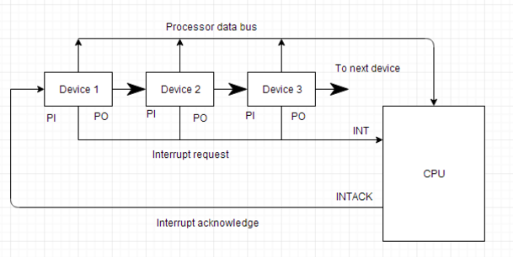
DAISY CHAINING PRIORITY SYSTEM
Serial connection
Highest Priority First
Lowest Priority Last
Common INTR Line
PI-Priority Input
PO-Priority Output
VAD-Vector Address
PI=1&PO=0&Highest Priority

Slide 39
PARALLEL PRIORITY INTERRUPT
The parallel priority interrupt method uses a register whose bits are set separately by the interrupt signal from each device.
Priority is established according to the position of the bits in the register.
In addition to the interrupt register, the circuit may include a mask register whose purpose is to control the status of each interrupt request.
The mask register can be programmed to disable lower-priority interrupts while a higher-priority device is being serviced.
It can also provide a facility that allows a high-priority device to interrupt the CPU while a lower-priority device is being serviced.

Slide 40
PARALLEL PRIORITY INTERRUPT
It consists of an interrupt register whose individual bits are set by external conditions and cleared by program instructions. The magnetic disk, being a high-speed device, is given the highest priority. The printer has the next priority, followed by a character reader and a keyboard.
The mask register has the same number of bits as the interrupt register. By means of program instructions, it is possible to set or reset any bit in the mask register.
Each interrupt bit and its corresponding mask bit are applied to an AND gate to produce the four inputs to a priority encoder.

Slide 41
PARALLEL PRIORITY INTERRUPT
In this way an interrupt is recognized only if its corresponding mask bit is set to 1 by the program. The priority encoder generates two bits of the vector address, which is transferred to the CPU.

Slide 42
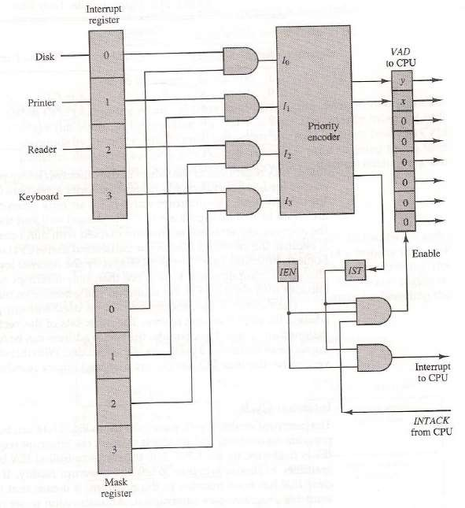

Slide 43
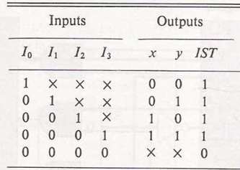
PRIORITY ENCODER TRUTH TABLE

Slide 44
SOFTWARE METHOD – POLLING
In this method, all interrupts are serviced by branching to the same service program.
This program then checks with each device if it is the one generating the interrupt. The order of checking is determined by the priority that has to be set.
The device having the highest priority is checked first and then devices are checked in descending order of priority. If the device is checked to be generating the interrupt, another service program is called which works specifically for that particular device.

Slide 45
MODES OF TRANSFER
A Data transfer between computer and I/O can be done in 3 ways,
Programmable I/O
Interrupt-Driven I/O and
Direct Memory Access (DMA).

Slide 46

INPUT – OUTPUT INTERFACE
Input Output Interface provides a method for transferring information between internal storage (such as memory and CPU registers) and external I/O devices.
Peripherals connected to a computer need special communication links for interfacing them with the central processing unit.
The purpose of communication link is to resolve the differences that exist between the central computer and each peripheral.

Slide 47
THE MAJOR DIFFERENCES ARE:-
Peripherals are electromechanically and electromagnetic devices and their manner of operation of the CPU and memory, which are electronic devices. Therefore, a conversion of signal values may be needed.
The data transfer rate of peripherals is usually slower than the transfer rate of CPU and consequently, a synchronization mechanism may be needed. Data codes and formats in the peripherals differ from the word format in the CPU and memory.
Peripherals- Byte, Block, … CPU or memory- word.
The operating modes of peripherals are different from each other and must be controlled so as not to disturb the operation of other peripherals connected to the CPU

Slide 48
PROGRAMMED I/O
The programmed I/O was the most simple type of I/O technique for the exchanges of data or any types of communication between the processor and the external devices. With programmed I/O, data are exchanged between the processor and the I/O module.
The processor executes a program that gives it direct control of the I/O operation, including sensing device status, sending a read or write command, and transferring the data.
When the processor issues a command to the I/O module, it must wait until the I/O operation is complete. If the processor is faster than the I/O module, this is wasteful of processor time.

Slide 49
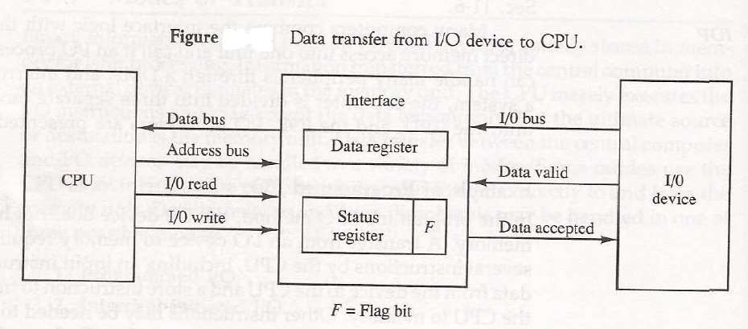
EXAMPLE OF PROGRAMMED I/O

Slide 50
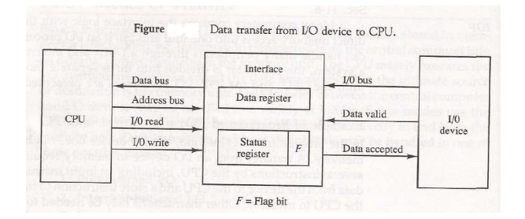
DATA TRANSFER FROM I/O DEVICE TO CPU
The I/O device transfers bytes of data one at a time as they are available. When a byte of data is available, the devices place it into the I/O bus and enables data valid line.
The interface accepts the byte into its data register and enables the data accepted line.
The interface sets a bit in the status register that is called as ‘F’ (or) “Flag” bit.
The device now disables the data valid line but it will not transfer another byte until data accepted line is disabled by interface this involves a handshaking procedure.
The status register is read and the value of flag bit is analyzed.
If the flag is equal to “1”, CPU reads the data from the data register. The flag bit is cleared to 0 by either the CPU or the interface depending on how the interface circuits are designed.
One flag is clears interface disables the data accepted line and the device can then transfer the next data byte.

Slide 51
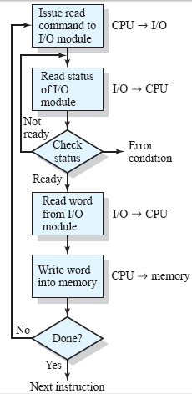
OPERATION OF PROGRAMMED I/O
CPU while executing a Program encounters an I/O instruction.
CPU issues Read command to I/O module.
I/O module performs the Requested action and set Status registers.
CPU is responsible to check Status registers periodically to see if I/O operation is complete. So
No interrupt to alert the processor.

Slide 52
DRAWBACK OF THE PROGRAMMED I/O
The main drawback of the Program Initiated I/O was that the CPU has to monitor the units all the times when the program is executing.
Thus the CPU stays in a program loop until the I/O unit indicates that it is ready for data transfer.
This is a time consuming process and the CPU time is wasted a lot in keeping an eye to the executing of program.

Slide 53
INTERRUPT DRIVEN I/O OVERVIEW
Interrupt controlled I/O is an alternative scheme dealing with I/O. Interrupt I/O is a way of controlling input/output activity whereby a peripheral or terminal that needs to make or receive a data transfer sends a signal.
This will cause a program interrupt to be set. At a time appropriate to the priority level of the I/O interrupt.

Slide 54

INTERRUPT DRIVEN I/O OVERVIEW
The CPU issues commands to the i/o module then proceeds with its normal work until interrupted by i/o device on completion of its work. For input, the device interrupts the cpu when new data has arrived and is ready to be arrived by the system processor .
.

Slide 55
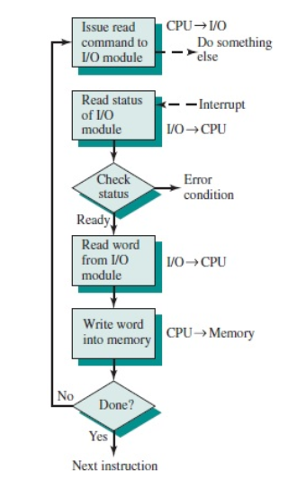
BASIC OPERATIONS OF INTERRUPT
CPU issues read command.
I/O module gets data from peripheral whilst CPU does other work.
I/O module interrupts CPU.
CPU requests data.
I/O module transfers data.

Slide 56

PERIPHERALS & PROCESSOR
COMPUTER ARCHITECTURE & ITS ORGANIZATON UNIT IV

Slide 57
PERIPHERALS & PROCESSOR
Input or output devices attached to the computer are called peripherals
Examples
Video monitors, Keyboard, printers etc
PROCESSOR
READY
HLDA
INTR
HOLD
INTA
SLOW SPEED PERIPHERAL
SAME SPEED PERIPHERAL
HIGH SPEED PHERIPHERAL
COMPUTER ARCHITECTURE & ITS ORGANIZATON UNIT IV

Slide 58
MODES OF TRANSFER
Data transfer to and from peripherals may be handled in one of the three modes
1. Programmed I/O
2. Interrupt initiated I/O
3. Direct memory access
COMPUTER ARCHITECTURE & ITS ORGANIZATON UNIT IV

Slide 59
MODES OF TRANSFER (Cntd….)
Programmed I/O
  Each data item transfer is initiated by an instruction in the program (time-consuming process)
Interrupt initiated I/O
  using an interrupt facility and special commands to inform the interface to issue an interrupt request signal when the data are available from the device
Direct Memory Access (DMA)
  the interface transfers data in and out of the memory unit through the memory bus.
COMPUTER ARCHITECTURE & ITS ORGANIZATON UNIT IV

Slide 60
INTERRUPT INITIATED I/O
An interrupt is a signal or a condition which cause the executing program to stop.
It is instructing the processor,
  To stop the current process
  To save the current state
  To attend the function call
Maskable Interrupt : An hardware interrupt which can be delayed with “wait” and attended after the high priority interrupt.
Non Maskable Interrupt: The hardware interrupt which cannot be delayed further which should be processed immediately.
COMPUTER ARCHITECTURE & ITS ORGANIZATON UNIT IV

Slide 61
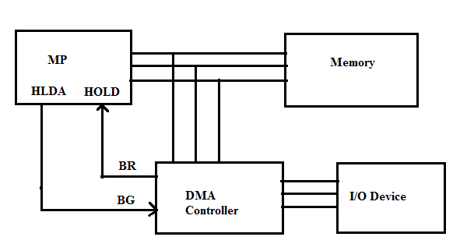
DIRECT MEMORY ACCESS (DMA)
DMA is an Integrated Circuit (IC) chip that acts as an interface between high speed peripheral and a processor.
COMPUTER ARCHITECTURE & ITS ORGANIZATON UNIT IV

Slide 62
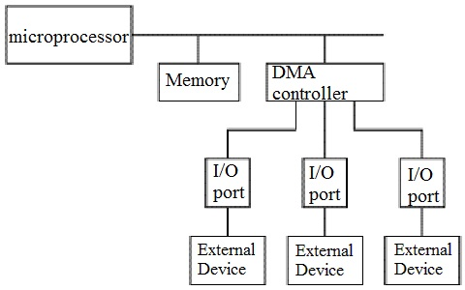
PERIPHERALS CONNECTED TO DMA
I/O ports of the high speed peripheral can access the memory directly by bypassing the processor but by using the buses of the processor
COMPUTER ARCHITECTURE & ITS ORGANIZATON UNIT IV

Slide 63
CPU INITIALIZES DMA
The CPU initializes the DMA by sending the following information through data bus:
The starting address of the memory where the data are available or where data are to be stored
The word count, which is the number of words in the memory block
Control to specify the mode of transfer such as read or write
A control to start DMA transfer
COMPUTER ARCHITECTURE & ITS ORGANIZATON UNIT IV

Slide 64
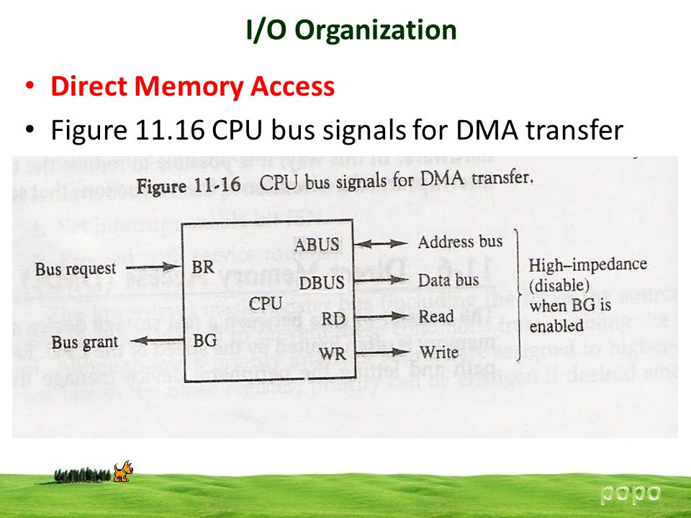
CPU BUS SIGNALS FOR DMA TRANSFER
The DMA communicates with the CPU via data bus and control lines .
The registers in DMA are selected by CPU through address bus by enabling the DS (DMA Select) & RS (Register Select)
COMPUTER ARCHITECTURE & ITS ORGANIZATON UNIT IV

Slide 65
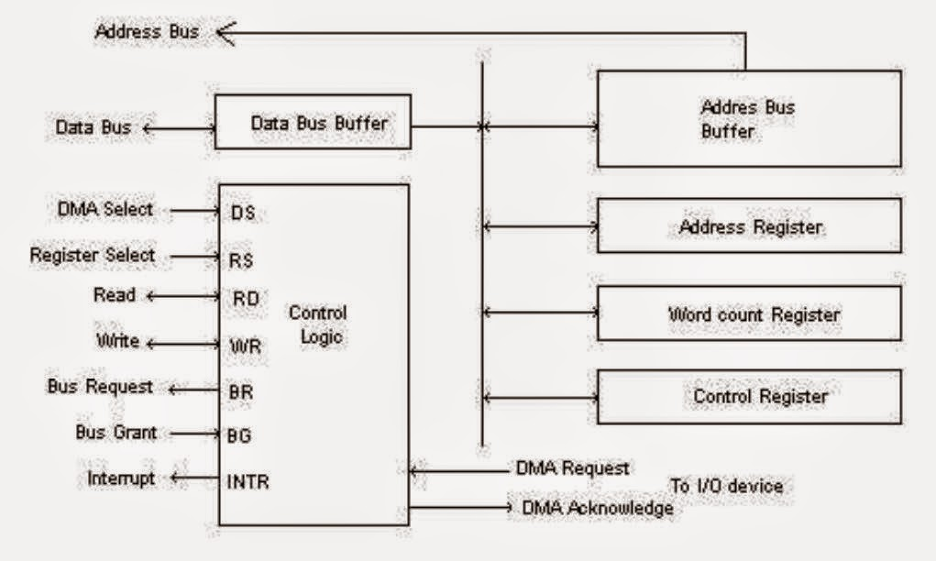
BLOCK DIAGRAM OF DMA CONTROLLER
COMPUTER ARCHITECTURE & ITS ORGANIZATON UNIT IV

Slide 66
BLOCK DIAGRAM OF DMA CONTROLLER (Cntd…)
DMA controller has three registers
Address register
It contains an address to specify the desired location in memory
Word count register
It holds the number of words to be transferred. (down counter)
Control register
It specifies the modes of transfer
COMPUTER ARCHITECTURE & ITS ORGANIZATON UNIT IV

Slide 67
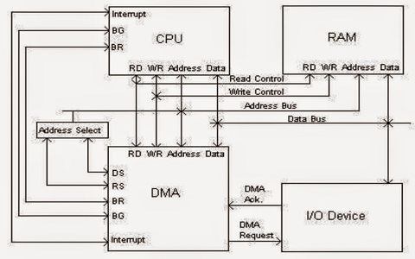
TRANSFER OF DATA BY DMA CONTROLLER
COMPUTER ARCHITECTURE & ITS ORGANIZATON UNIT IV

Slide 68
DMA TRANSFER
DMA controller has to share the bus with the processor to make the data transfer.
The device that holds the bus at a given time is called bus master.
When a transfer from I/O device to the memory or vice verse has to be made, the processor
  stops the execution of the current program,
  increments the program counter,
  moves data over stack
  then sends a DMA select signal to DMA controller over the address bus.
If the DMA controller is free, it requests the control of bus from the processor by raising the bus request signal.
Processor grants the bus to the controller by raising the bus grant signal, now DMA controller is the bus master.
The processor initiates the DMA controller by
  sending the memory addresses,
  number of blocks of data to be transferred
  direction of data transfer.
COMPUTER ARCHITECTURE & ITS ORGANIZATON UNIT IV

Slide 69
DMA TRANSFER (Cntd…)
DMA controller now has the full control of buses and can interact directly with memory and I/O devices independent of CPU.
It makes the data transfer according to the control instructions received by the processor.
For each word that is transferred, the DMA increments its address register and decrements the word count register.
If the word count register reaches zero, the DMA stops any further transfer and removes its bus request.
It also informs the CPU of the termination by means of an interrupt.
CPU responds to the interrupt, it reads the content of word count register.
The zero value of this register indicates that all the words were transferred successfully
COMPUTER ARCHITECTURE & ITS ORGANIZATON UNIT IV

Slide 70
DIFFERENT MODES OF DMA TRANSFER
a) Burst Mode:
  In this mode DMA handover the buses to CPU only after completion of whole data transfer.
  Meanwhile, if the CPU requires the bus it has to stay ideal and wait for data transfer.
b) Cycle Stealing Mode:
  In this mode, DMA gives control of buses to CPU after transfer of every byte.
  It continuously issues a request for bus control, makes the transfer of one byte and returns the bus.
  By this CPU doesn’t have to wait for a long time if it needs a bus for higher priority task.
c) Transparent Mode:
  Here, DMA transfers data only when CPU is executing the instruction which does not require the use of buses.
COMPUTER ARCHITECTURE & ITS ORGANIZATON UNIT IV

Slide 71
ADVANTAGES & DISADVANTAGES OF DMA
Advantages
  DMA speedups the memory operations by bypassing the involvement of the CPU.
  The work overload on the CPU decreases.
  For each transfer, only a few numbers of clock cycles are required
Disadvantages
  As it is a hardware unit, it would cost to implement a DMA controller in the system.
  Cache coherence problem can occur while using DMA controller.
.
COMPUTER ARCHITECTURE & ITS ORGANIZATON UNIT IV

Slide 72
KEY POINTS
DMA is an abbreviation of Direct Memory Access
DMA is a method of data transfer between main memory and peripheral devices
The hardware unit that controls the DMA transfer is a DMA controller
DMA controller transfers the data to and from memory without the participation of the processor
The processor provides the start address and the word count of the data block which is transferred to or from memory to the DMA controller and frees the bus for DMA controller to transfer the block of data
COMPUTER ARCHITECTURE & ITS ORGANIZATON UNIT IV

Slide 73
KEY POINTS (Cntd…)
DMA controller transfers the block of data to and from memory in three modes burst mode, cycle steal mode and transparent mode.
DMA can be configured in various ways it can be a part of individual I/O devices, or all the peripherals attached to the system may share the same DMA controller.
Thus the DMA controller is a convenient mode of data transfer.
It is preferred over the programmed I/O and Interrupt-driven I/O mode of data transfer
COMPUTER ARCHITECTURE & ITS ORGANIZATON UNIT IV

